Slide 1
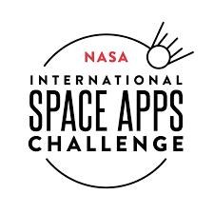
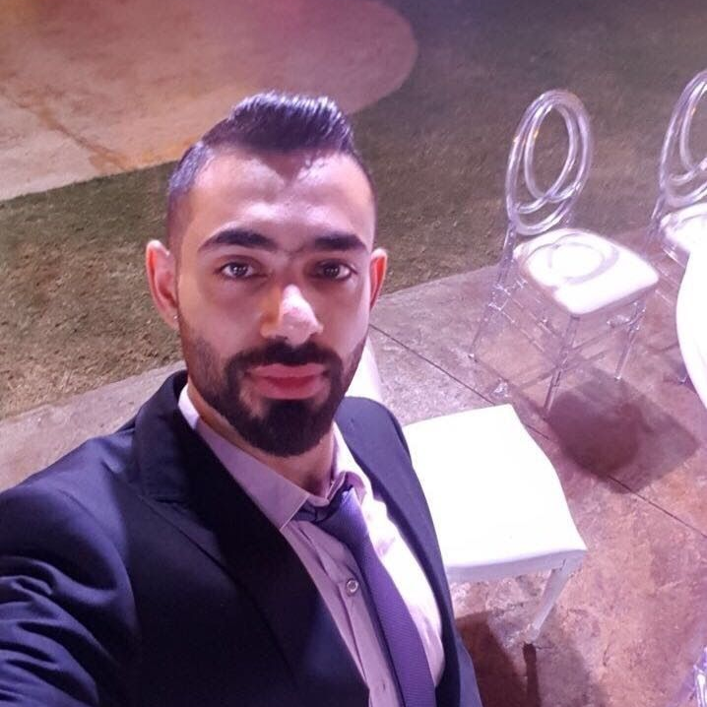
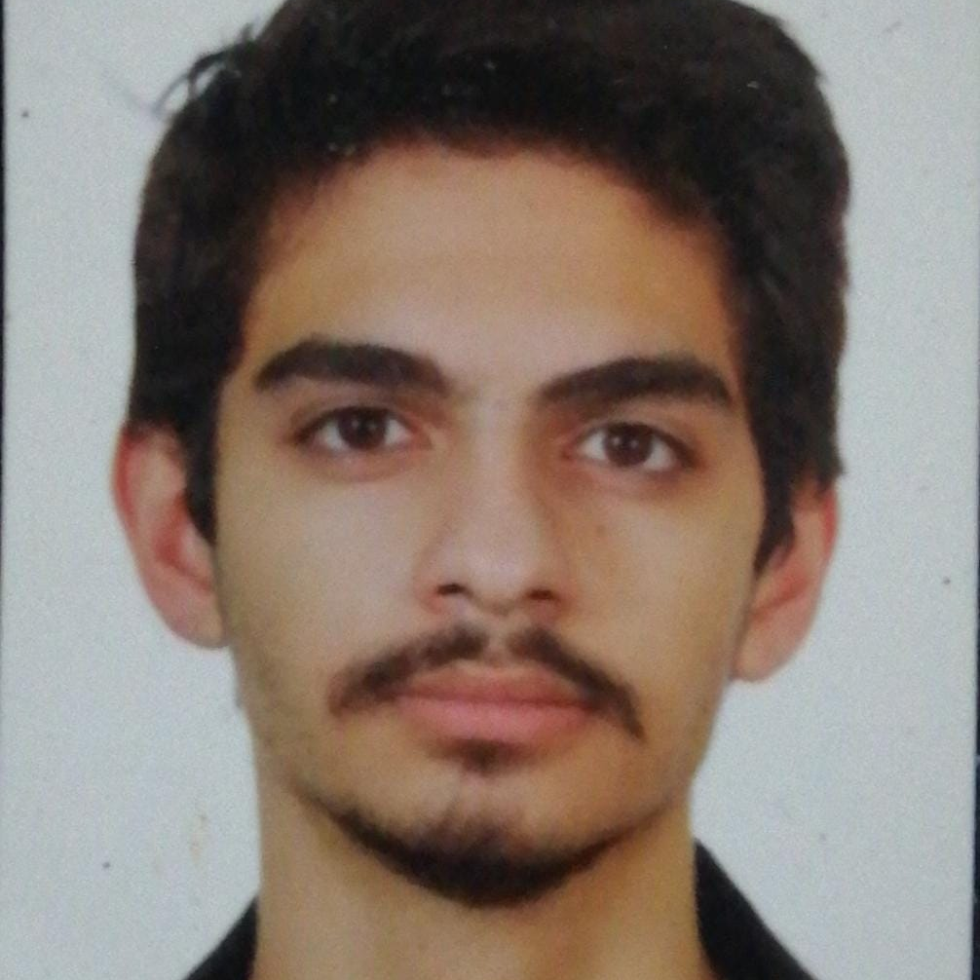
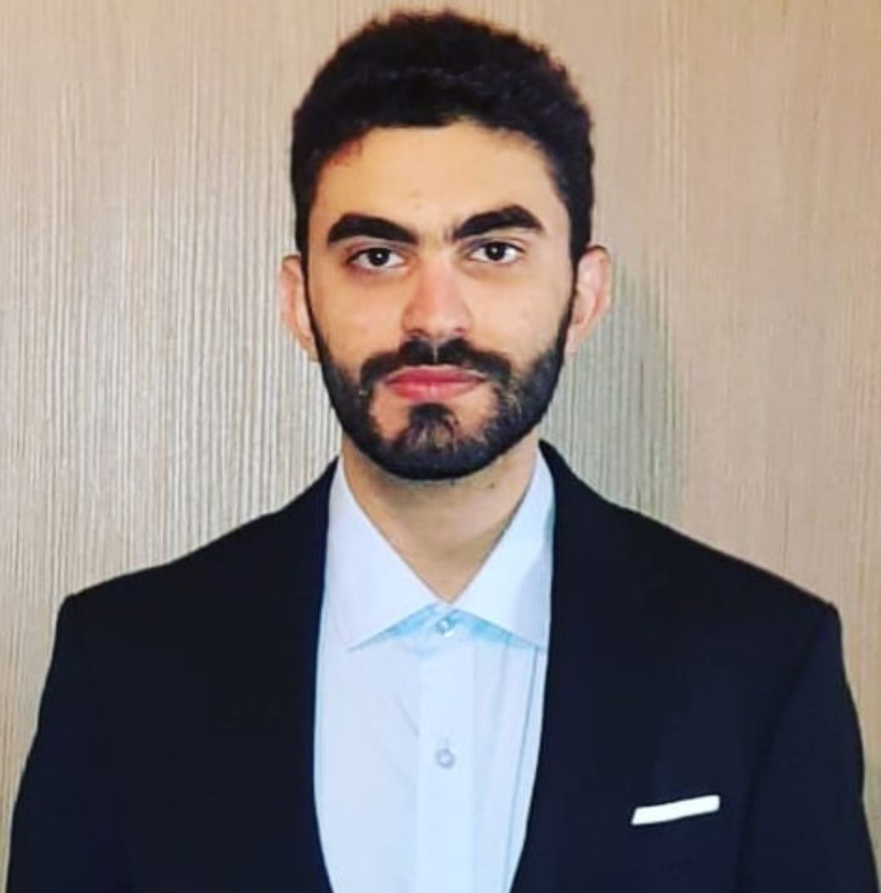
DARK MATTER
NASA SPACE APPS CHALLENGE – The Art in Our Worlds
Nour Bou Nasr
Nassim Bou Nasr
Charbel Al Sahlani
Team Representative, Deep Learning and AI Engineer
Front-End Developer
Deep Learning and AI Engineer

Slide 2
The Arts in Our Worlds Challenge
Objective
Give the user the ability to style and modify the image
Stimulate the user’s imagination and creativity
Allow the user to explore different results from different combinations of tools and styles
Make the App accessible for non-English speakers
Sharing capabilities, to motivate the user to share their work with the world

Slide 3
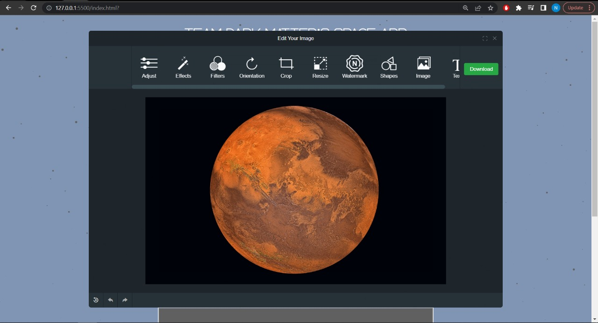
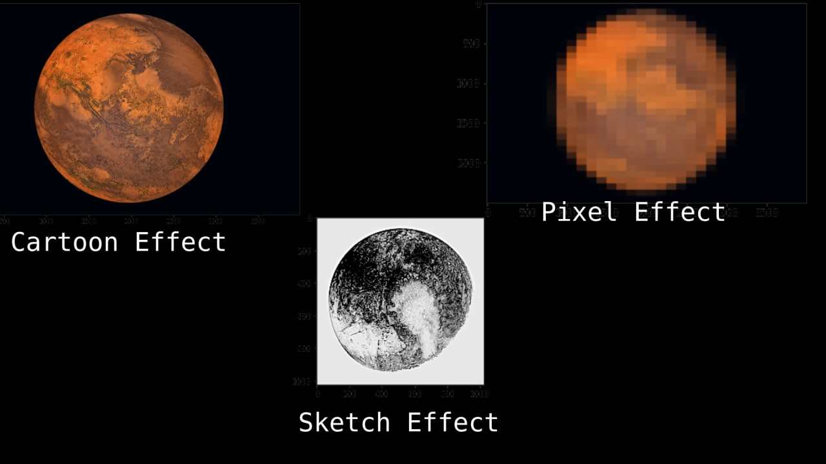
SOLUTION
Two Parts Solution
Front-end
Back-end
Interactive UX/UI
Mini game to keep the user entertained
Easy access to all of the available tools
Preview changes feature
Optimized fast searching algorithm
Neural Style Transfer algorithm
The entire functionality of the app’s features
The Source code of the mini game

Slide 4
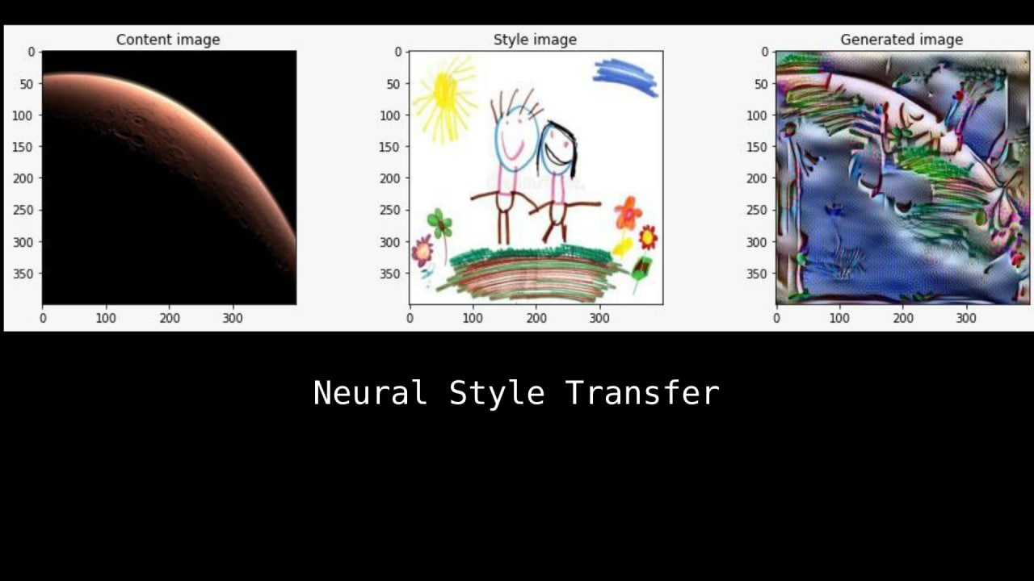
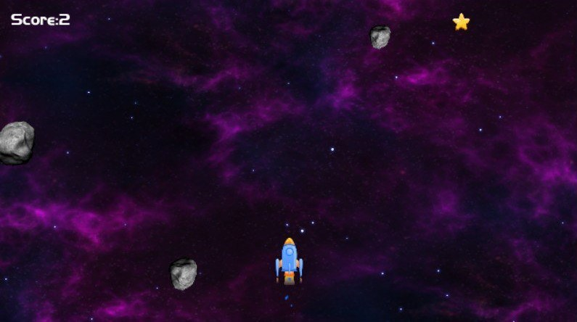
Unique Features
Where creativity meets Ingenuity
NASA’S image with your own art style
Fast search & Mini game
Style NASA’s image with your own painting style or the style of your favorite painter
Further image processing features (filters, enhancers, crop, rotate, etc.)
Play a Mini game as you wait for the neuro styled image to generate
Efficient search using CLIP

Slide 5
What Could We Have Accomplished More
Given more time we would have accomplished the following:
Image generation from text alone using GAN (Generative Adversarial Networks)
Adding more image styling algorithms
Adding more language support
Improving the image generation time

Slide 6
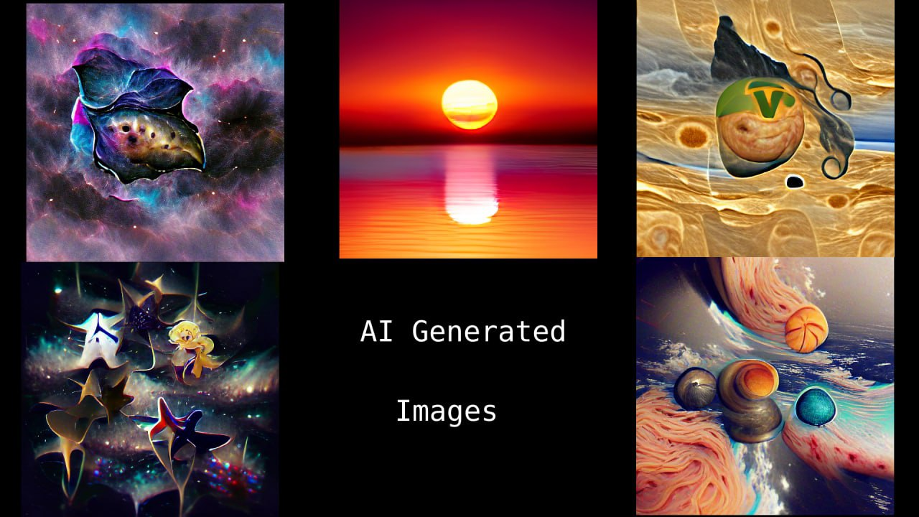
Future Works
In the future we plan to do the following:
Create AR (augmented reality) objects
Release the application on the Apple App Store and Google Play store
Adding the ability to get featured on the app for getting a certain number of likes on social media
Adding the option to get paid for your beautiful creations

Slide 7
The Art in Our Worlds Challenge
The Outcome
Accessible GUI
Fun mini Game
Live preview
Interactive
Encouragement to draw and paint
Room to innovate
Art appreciation
Creative
Thought provoking concept
Right brain stimulation
Curiosity encouragement
Inspirational

